Slide 1



Do not edit
How to change the design
Join at slido.com
#2568271
Presenting with animations, GIFs or speaker notes? Enable our Chrome extension
Notes:
📣 This is Slido interaction slide, please don't delete it.
✅ Click on 'Present with Slido' and the joining instructions will appear when you get to this slide.

Slide 2
Exploratory Data Analysis (EDA) II
⚠️ Reminder to start the Zoom recording!
LECTURE 3
Fundamental tabular manipulations and visualizations
Data 100/Data 200, Fall 2026 @ UC Berkeley
Ramesh Sridharan and Jeremy Sanchez
Content credit: Acknowledgments

Slide 3
Announcements!
Prerequisite Quiz logistics are on Ed.
The testing window is Tuesday 9/8 to Thursday 9/10.
Sign up for a slot on PrairieTest ASAP!
Homework 00 due tomorrow!
Homework 1 will be released tomorrow.
Need a refresher on SQL? See linked materials from #94 on Ed.
Want to talk 1:1 with Ramesh about grad school, career, life? Sign up here for a 15-minute slot!
Priority for slots before 10/15 goes to juniors/seniors (graduation date ≤ Spring ‘28)
Notes:
Slightly formalized in wording, but still mostly the same:
Ask a Question
Obtain Data
Understand the Data
Understand the World

Slide 4
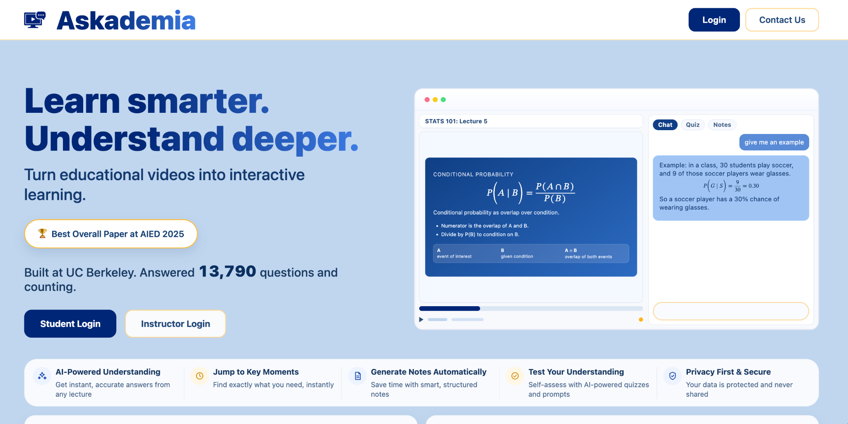
www.askademia.org

Slide 5
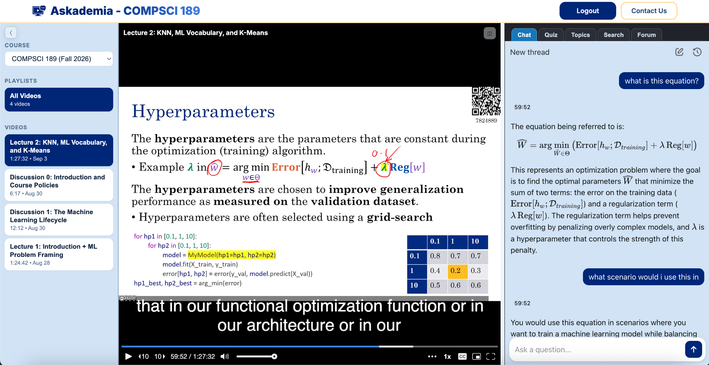
www.askademia.org

Slide 6
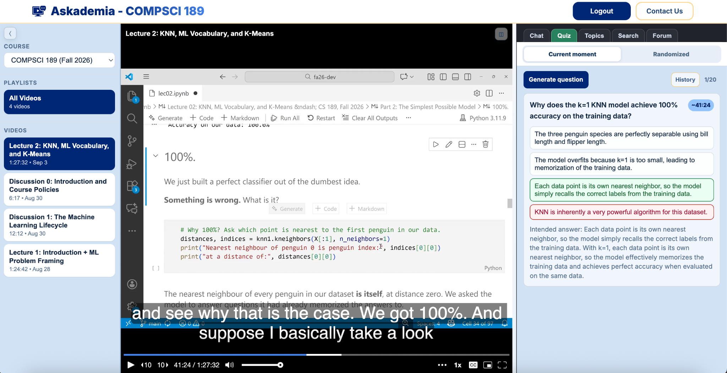
www.askademia.org

Slide 7
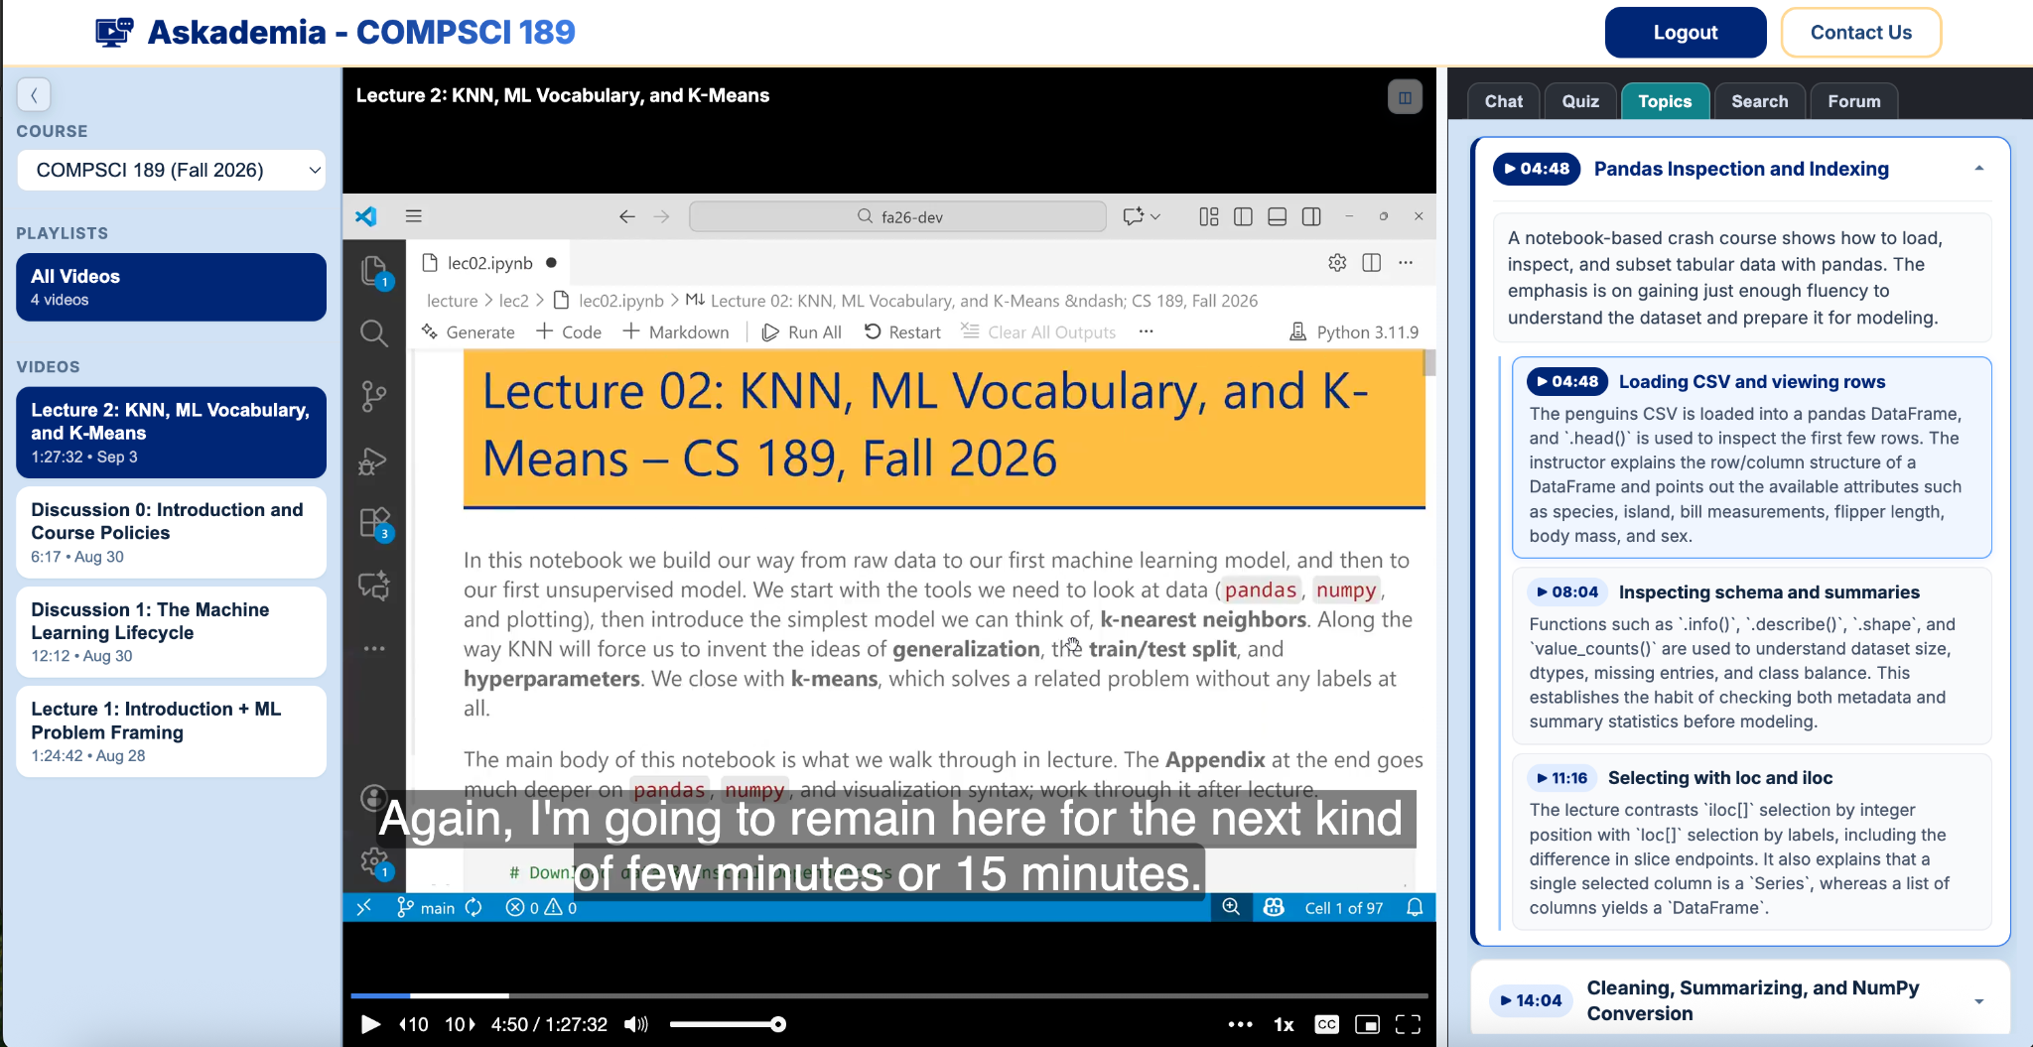
www.askademia.org

Slide 8
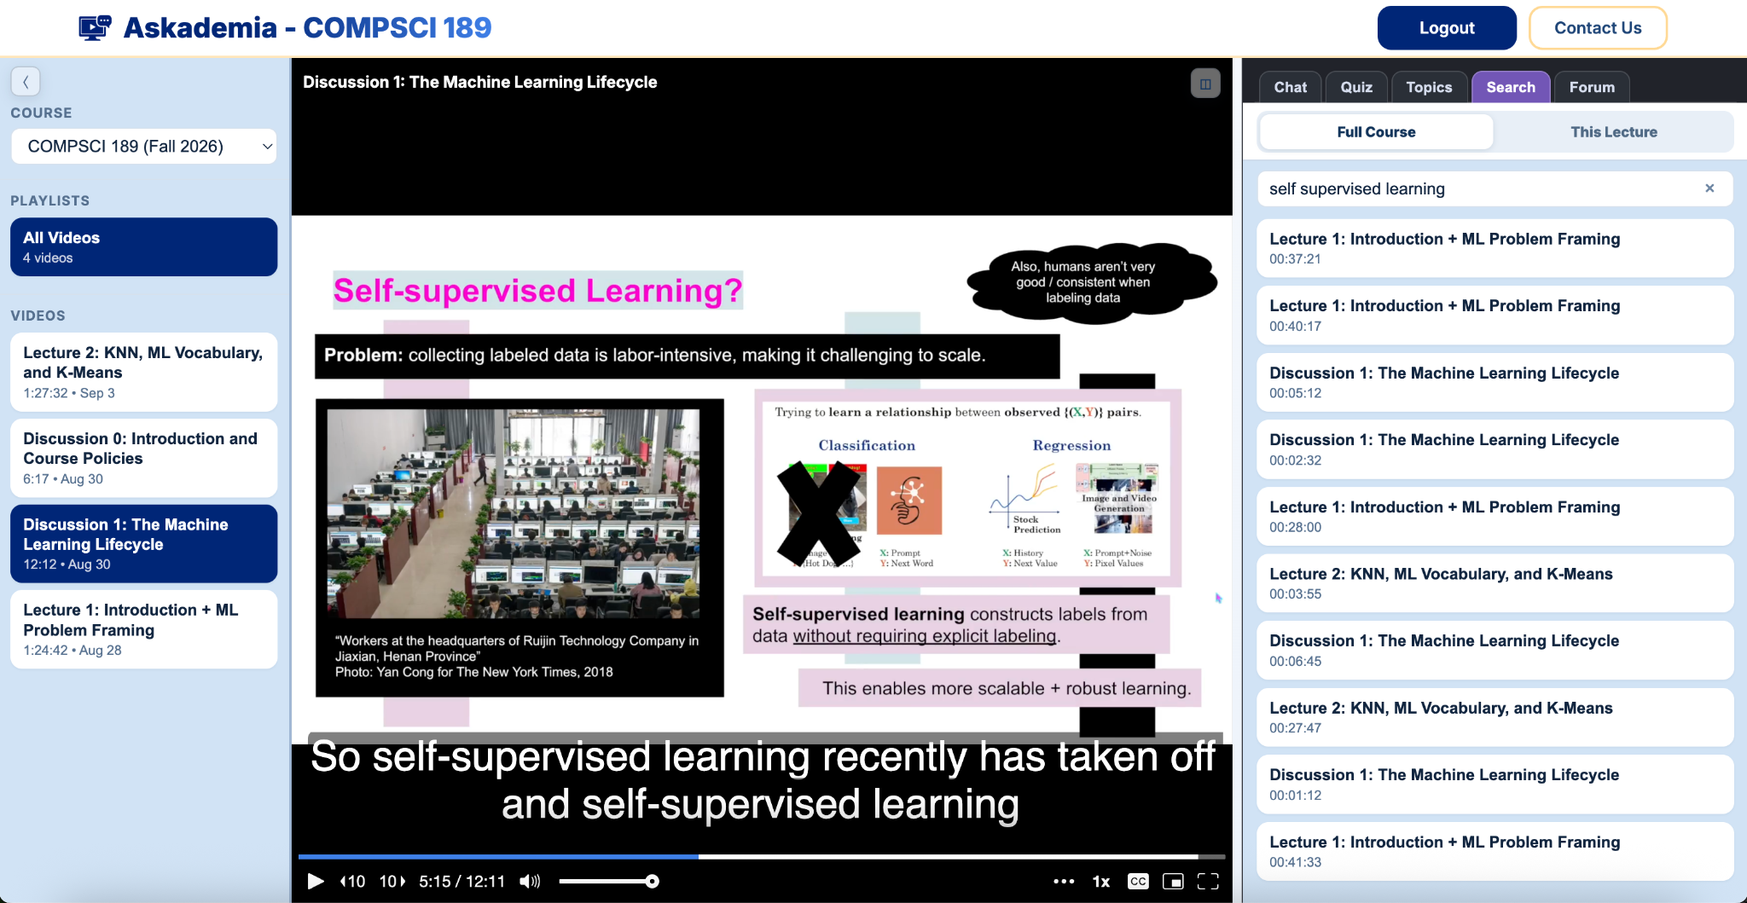
www.askademia.org

Slide 9
Recap: Relevant questions about the admissions dataset
Task: Your manager asks you to identify five California public high schools that defy typical patterns of application, admission, and/or attendance.
Do you trust the data? How closely does it correspond to the truth? Context and inspection.
Which schools have the highest application/admission/attendance rates? Extremes.
How much do application/admission/attendance rates differ across schools? Distributions and variation.
Are other school characteristics related to the rates above? Correlation.

Slide 10
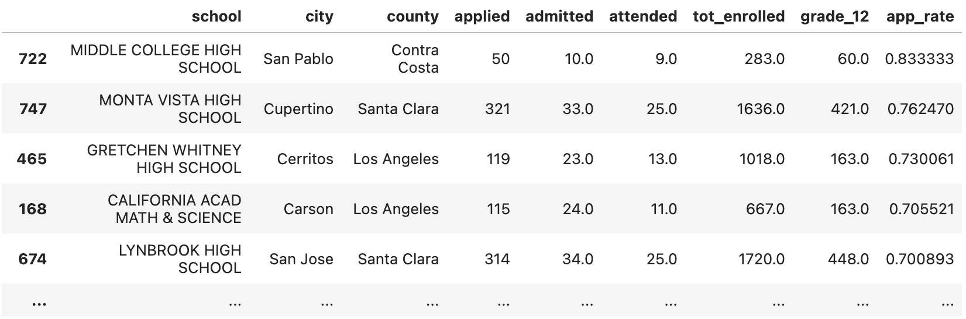
Recap: Our Task and Our First Answer
We got an answer (by sorting by our new app_rate column): what haven’t we covered yet?
low application rates, admission/attendance, define "typical pattern", etc.
One school is small / another is specialized
🧙 One of the key tasks of a data scientist is to define "success". You'll often need to transform fuzzy instructions into concrete goals or metrics.
Task: Your manager asks you to identify five California public high schools that defy typical patterns of application, admission, and/or attendance.

Slide 11
Recap: Learning Polars and SQL
English | Polars Code | SQL Query
Load in the dataset. Show a preview of the data. | df = pl.read_csv('pivoted-ucb-admissions.csv') df | SELECT * FROM admissions
Select just the 'school' and 'admitted' columns. | df.select(pl.col('school'), pl.col('admitted')) df.select('school', 'admitted') | SELECT school, admitted FROM admissions
Find the minimum of the 'applied' column. | df['applied'].min() | SELECT MIN(applied) FROM admissions
Sort the dataset in ascending order by the 'applied' column. | df.sort('applied', descending=False) | SELECT * FROM admissions ORDER BY applied ASC
Count the number of rows in the dataset. | len(df) OR df.shape[0] | SELECT COUNT(*) FROM admissions
Create a new column with the application rate for each school. | df = df.with_columns( app_rate=pl.col('applied') / pl.col('grade_12') ) OR df = df.with_columns( (pl.col('applied') / pl.col('grade_12')).alias('app_rate') ) | SELECT applied / grade_12 AS app_rate FROM admissions
Filter data to rows where app_rate <= 1. | df_new = df.filter(pl.col('app_rate') <= 1) | SELECT applied/grade_12 AS app_rate FROM admissions WHERE app_rate <= 1

Slide 12
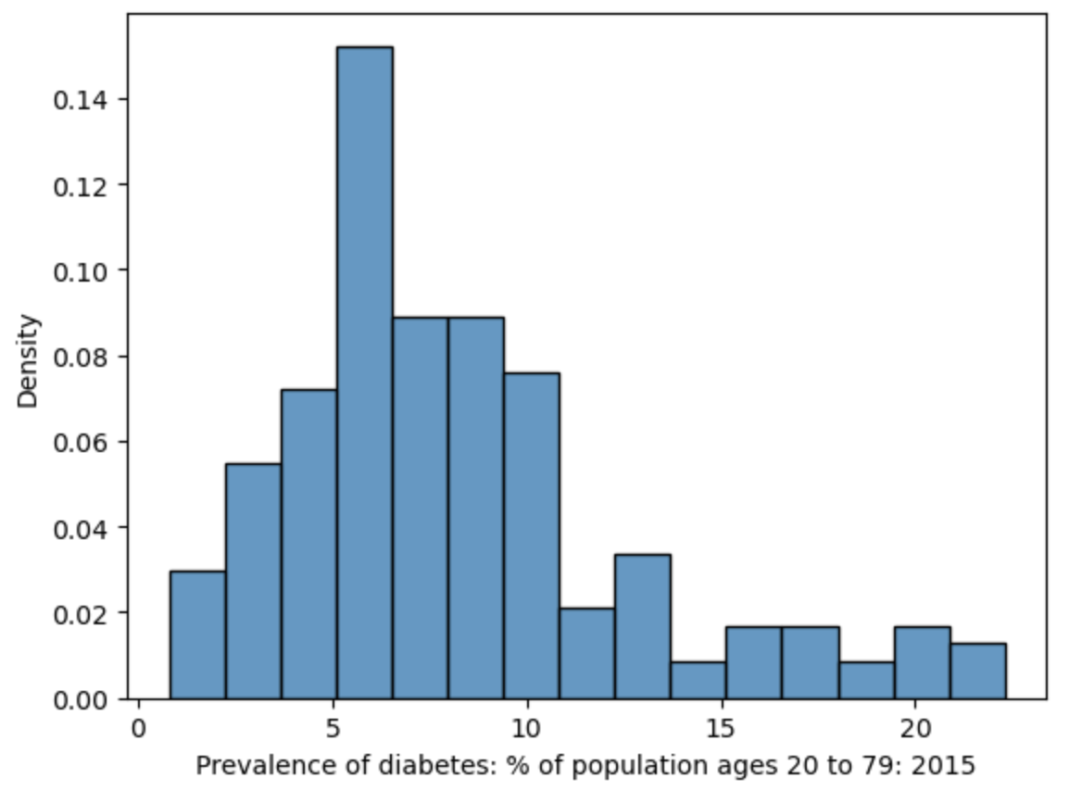
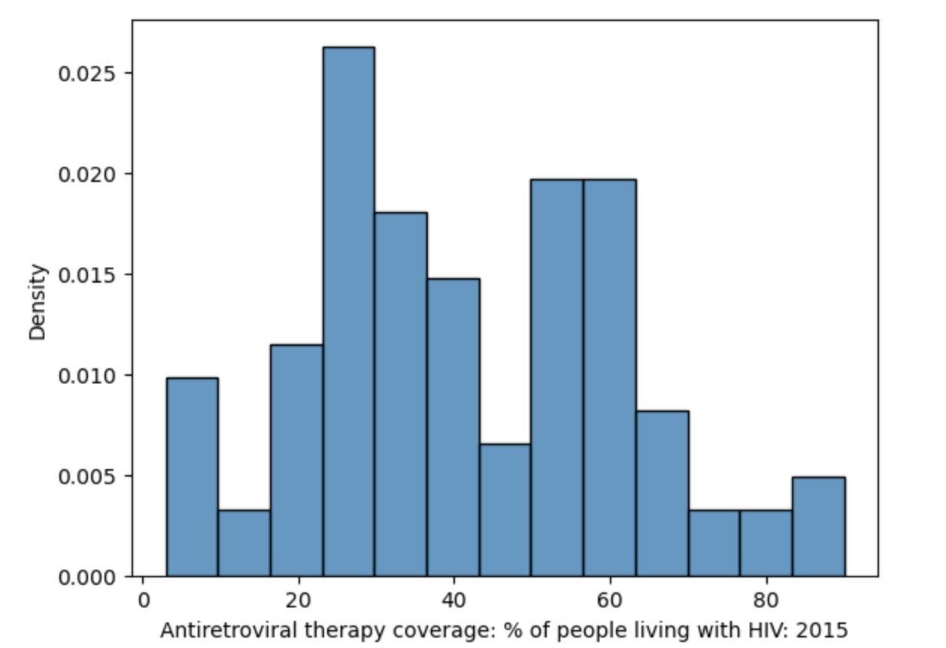
Recap: Interpreting Histograms
The mode is the most frequent value of a distribution.
A distribution with one clear peak is called unimodal.
Two peaks: bimodal.
More peaks: multimodal.
Bimodal?
Unimodal

Slide 13
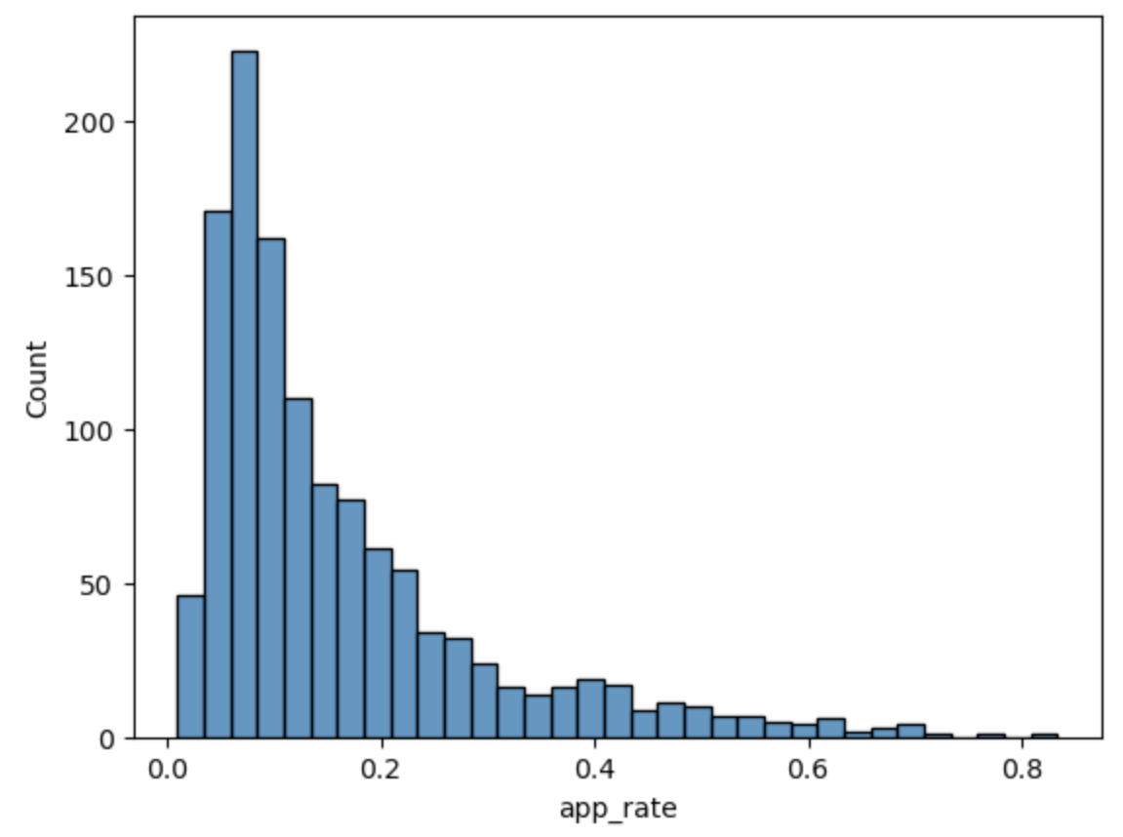
Why does this pattern exist?
Why is there so much variation in application rates across schools?

Slide 14

Do not edit
How to change the design
Why is there so much variation in application rates across schools?
Presenting with animations, GIFs or speaker notes? Enable our Chrome extension
Notes:
📣 This is Slido interaction slide, please don't delete it.
✅ Click on 'Present with Slido' and the poll will launch automatically when you get to this slide.

Slide 15
Why does this pattern exist?
Why is there so much variation in application rates across schools?
Lots of reasons. The decision to apply is complex.
Money, distance, academic resources, individual and family priorities … do we have this data?

Slide 16


Slide 17
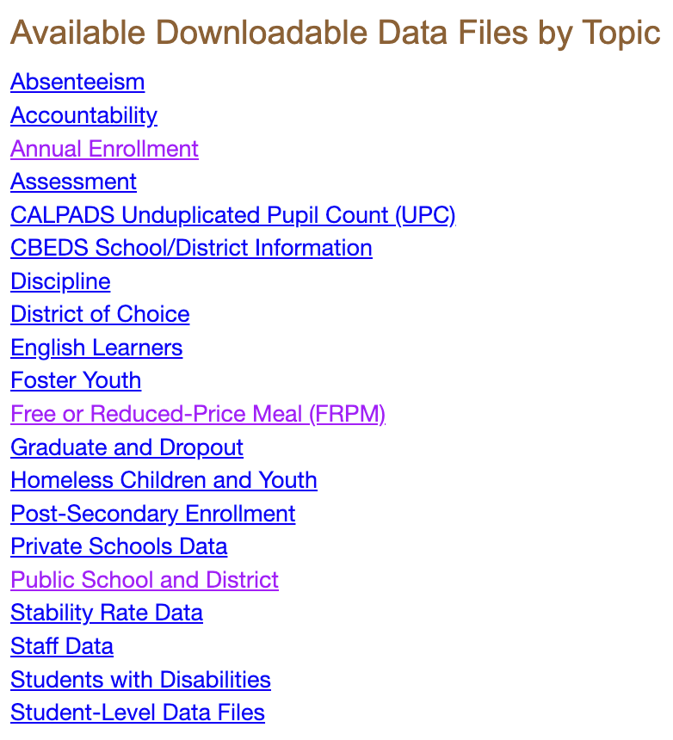
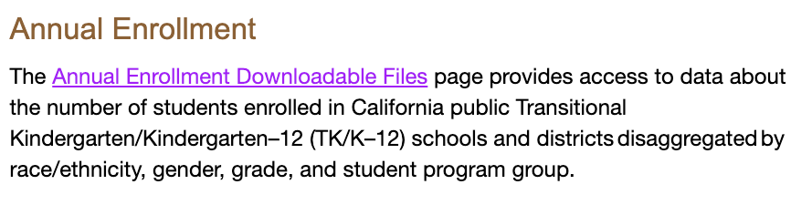
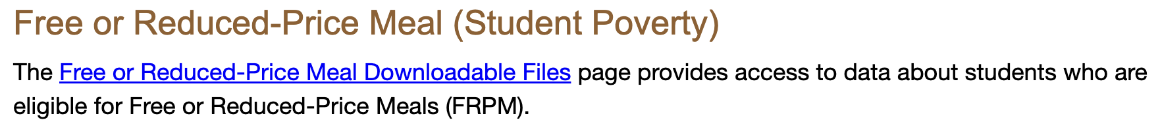
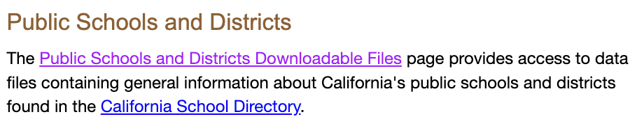
This is where we got the 12th grade count!
Proxy for average socioeconomic status.
Latitude/longitude of each school → Calculate distance to Berkeley?
Identify charter schools (i.e., more flexible/specialized)

Slide 18
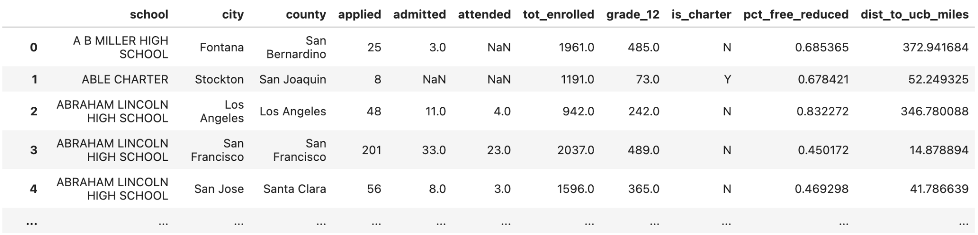
Joining in More New Data
Join the UC admissions data to the expanded California public schools data.
🧑‍💻 Personal project idea: Reproduce these joins from scratch. Download the raw data and talk to an LLM!

Slide 19
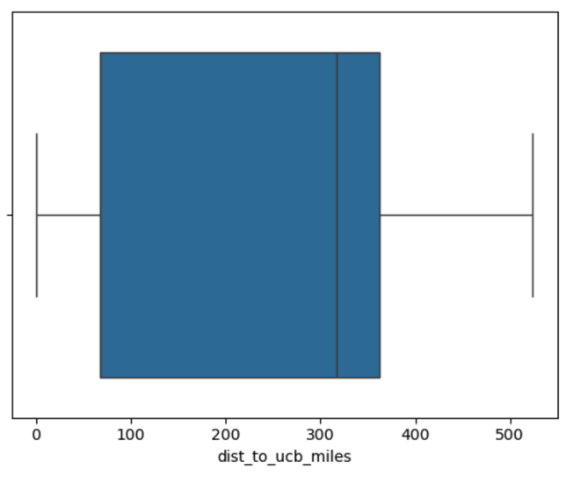
Distribution of Distances to UC Berkeley from each school
What is the variation in distance to UC Berkeley across schools?
English | Seaborn Code
Make a boxplot of the values in dist_to_ucb. | sns.boxplot(df_new, x='dist_to_ucb')

Slide 20
Do not edit
How to change the design
Here is the boxplot of dist_to_ucb_miles. Describe the shape of the histogram of dist_to_ucb_miles.
Presenting with animations, GIFs or speaker notes? Enable our Chrome extension
Notes:
📣 This is Slido interaction slide, please don't delete it.
✅ Click on 'Present with Slido' and the poll will launch automatically when you get to this slide.

Slide 21
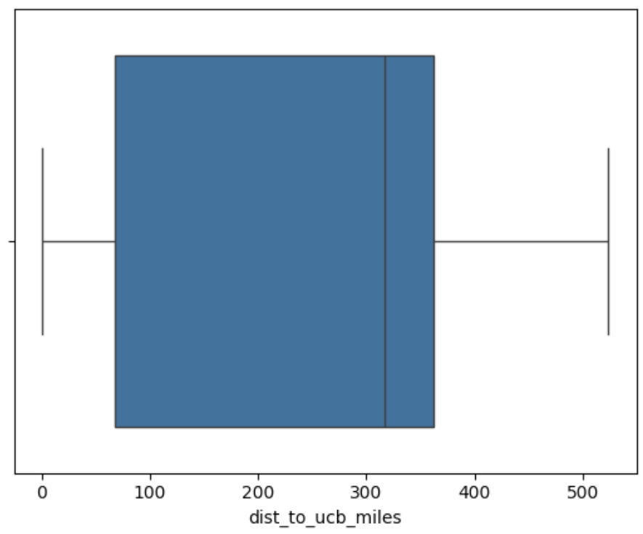
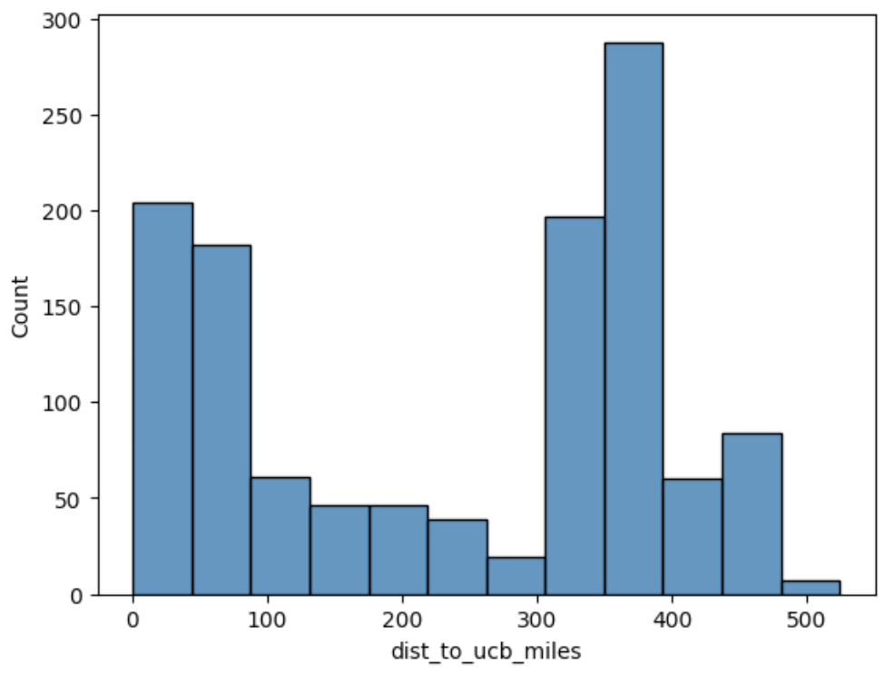
Boxplots and histograms are not interchangeable
Boxplots cannot show modality (i.e., number of peaks). But they are easier to glance at.
English | Seaborn Code
Make a histogram of the values in dist_to_ucb. | sns.histplot(df, x='dist_to_ucb')

Slide 22
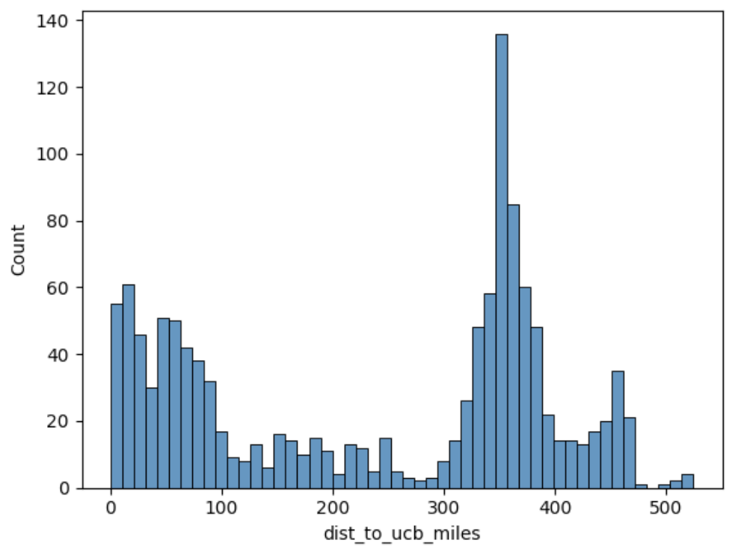
More bins → More detail
Add more bins to see more detail.
English | Seaborn Code
Make a histogram of the values in dist_to_ucb, using 50 bins. | sns.histplot(df, x='dist_to_ucb', bins=50)

Slide 23
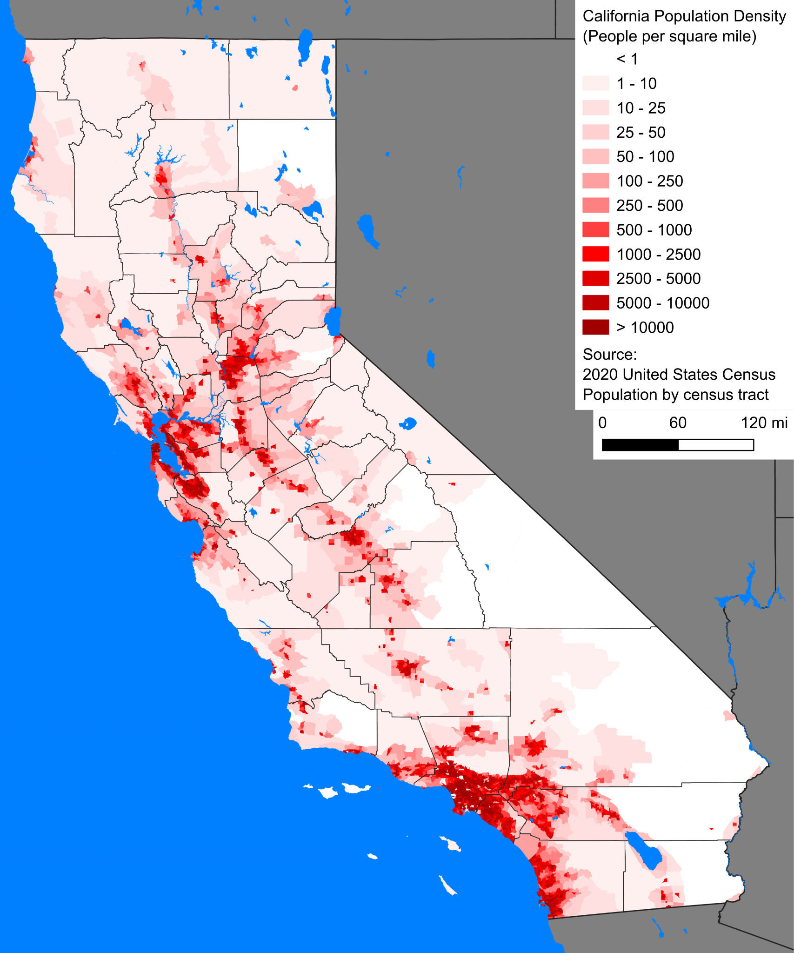

Connecting plots to real-world phenomena
Why are there three peaks (i.e., three modes, or trimodal)?

Slide 24
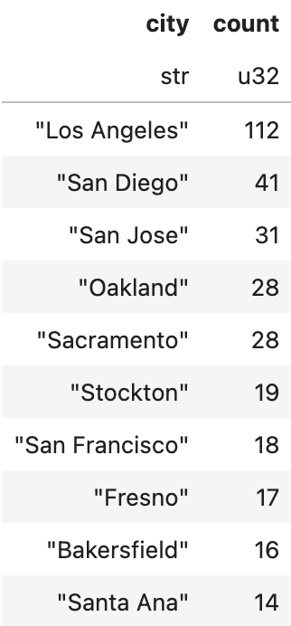
Connecting plots to real-world phenomena
There are three population hubs in California: Bay Area, LA/Orange County, and San Diego.
English | Polars code | SQL code
For each city, count the number of rows. | df['city'] .value_counts() .sort('count', descending=True).head(10) | SELECT COUNT(*) FROM admissions GROUP BY city

Slide 25
Back to application rates
Why is there so much variation in application rates across schools?
Lots of reasons. This is a hard issue.
Money, distance, academic resources, individual and family priorities, …
Starting point: How do application rates correlate with free reduced lunch (FRL) percentage?

Slide 26
Possible questions about the admissions dataset
Do you trust the data? How closely does it correspond to the truth? Context and inspection.
Which schools have the highest application/admission/attendance rates? Extremes.
How much do application/admission/attendance rates differ across schools? Distributions and variation.
How are distance from UC Berkeley, average socioeconomic status, free/reduced lunch percentage, and charter status related to the rates above? Correlation.
More on this one next time!

Slide 27
Reminder: The (augmented) admissions dataset

Slide 28
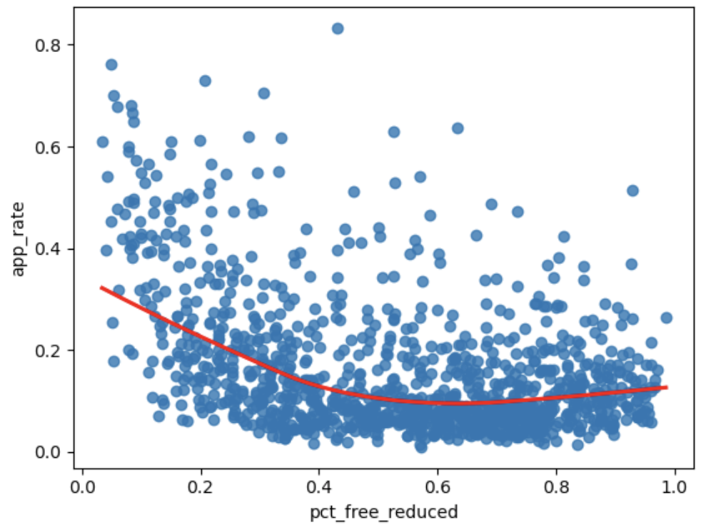
You are the driver, not the LLM
Do not let LLMs do the thinking for you.
You do the thinking, and then you can let an LLM help implement your ideas.
Cognitive offloading is becoming a huge problem: "Over four months, LLM users consistently underperformed at neural, linguistic, and behavioral levels."
English | Seaborn code
Make a scatter plot with pct_free_reduced on the x-axis and app_rate on the y-axis, and add a red LOWESS line. | sns.regplot(df_new, x='pct_free_reduced', y='app_rate',\ lowess=True, line_kws={"color": "red"})
kws: keywords

Slide 29
LOWESS intuition
You can think of LOWESS as finding the average of all points within each "bin" of the data, and then connecting the dots.
[ This is an over-simplification. ]
Should every point in this plot equally influence the shape of the line?

Slide 30
Weights of data points
Should every data point contribute equally to the LOWESS line?
Probably not.
Some schools have many more students than other schools.
Bigger schools should have greater weight than smaller schools.
Note: We would have to use more specialized tools than Seaborn to introduce different weights to LOWESS.

Slide 31

Do not edit
How to change the design
What should be our choice of weight for each data point?
Presenting with animations, GIFs or speaker notes? Enable our Chrome extension
Notes:
📣 This is Slido interaction slide, please don't delete it.
✅ Click on 'Present with Slido' and the poll will launch automatically when you get to this slide.

Slide 32
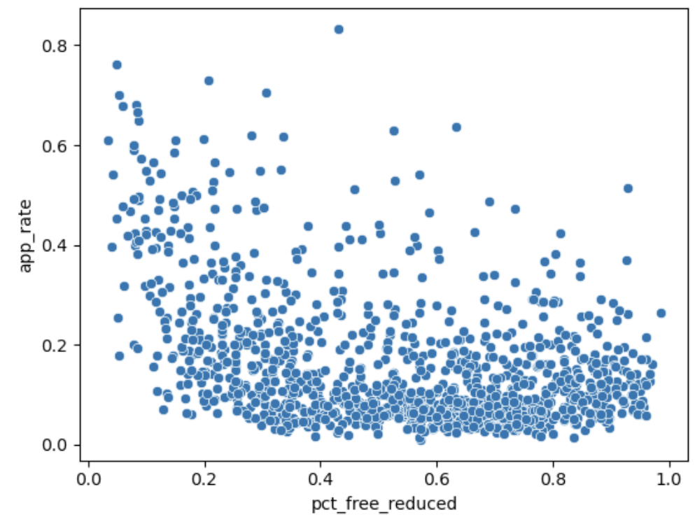
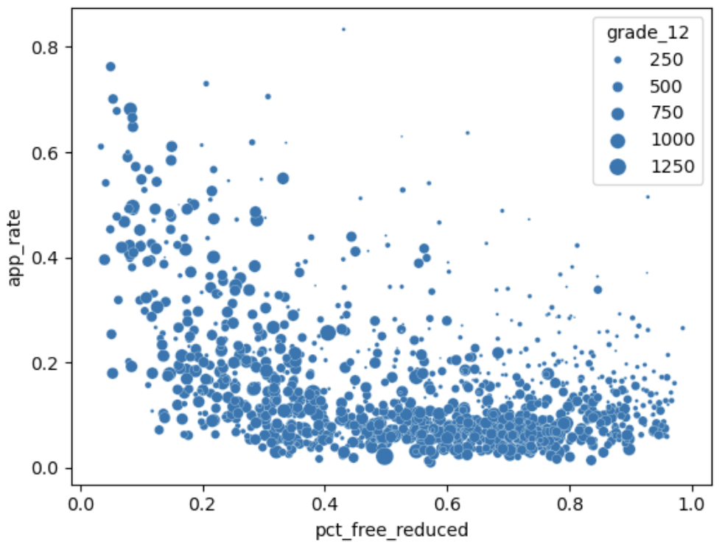
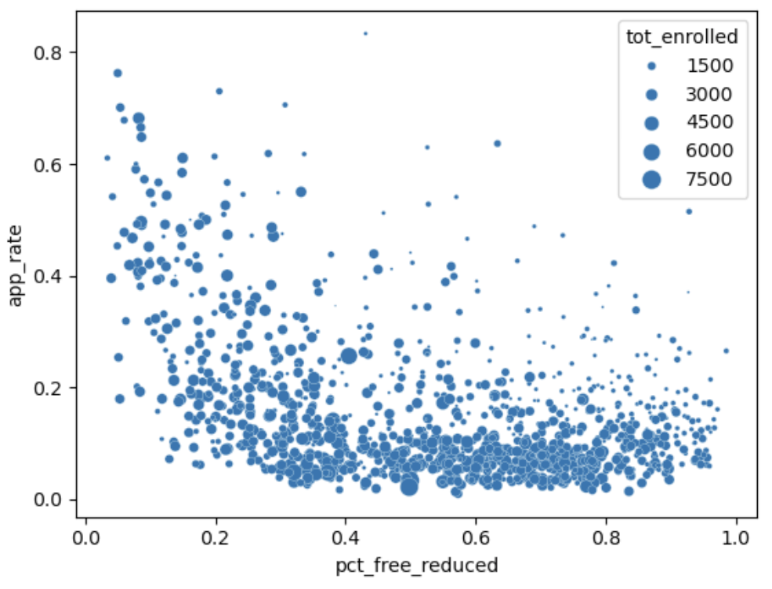
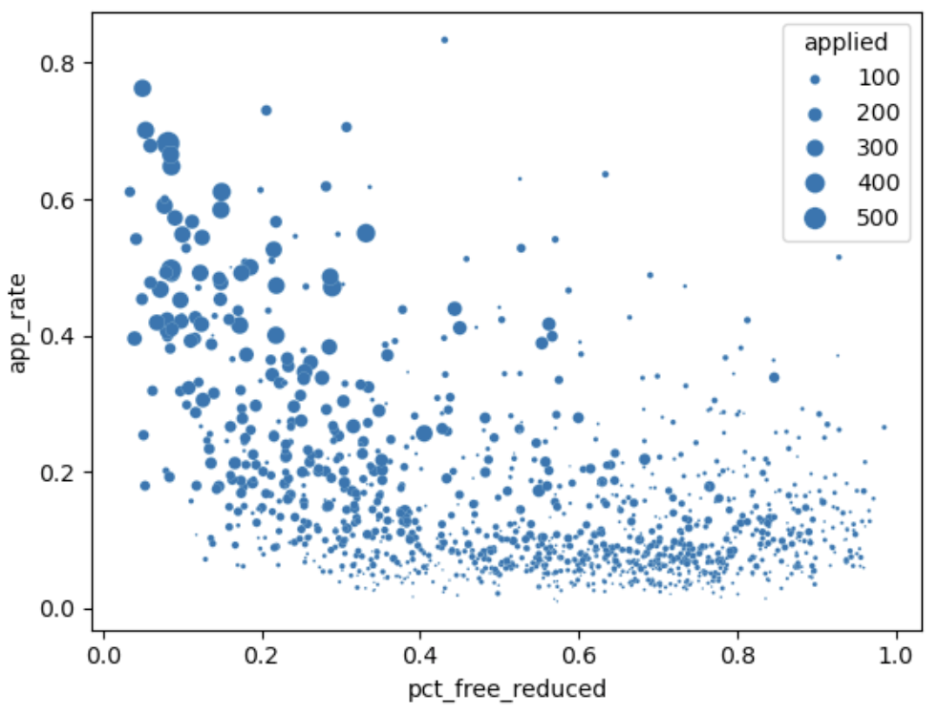
What does each plot communicate?
B
A
A - Misleading. The schools towards the top right are actually quite small!
B/C - Mostly identical to each other. Differences from dropout rates and # grades offered.
C
D
D - Somewhat redundant with y-axis. Schools with low app_rate will have lower counts of students who applied.

Slide 33
Do not edit
How to change the design
Which plot is better?
Presenting with animations, GIFs or speaker notes? Enable our Chrome extension
Notes:
📣 This is Slido interaction slide, please don't delete it.
✅ Click on 'Present with Slido' and the poll will launch automatically when you get to this slide.

Slide 34
Take a stand!
Which plot is "better"?
B
D
Depends on what you're trying to communicate. Do you want to know where possible applicants exist, or do you want to know where most actual applicants come from?

Slide 35
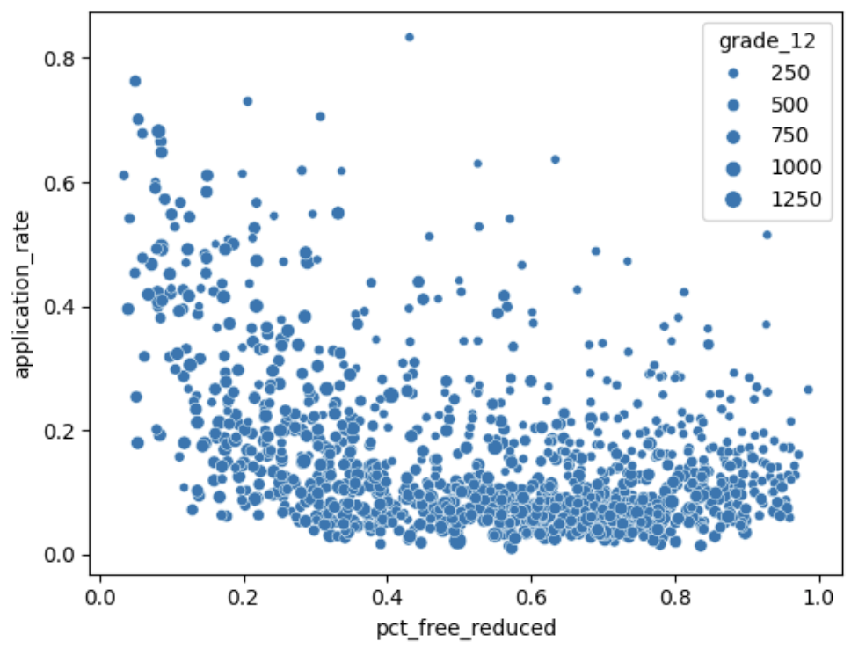
Scatterplot sized by a third variable
One logical possibility is to resize the points by the number of "potential" applicants.
There is no correct answer here. This decision is yours to make as the storyteller!
English | Seaborn code
Make a scatter plot with pct_free_reduced on the x-axis and app_rate on the y-axis, with points sized by 12th grade enrollment. | sns.scatterplot(df_new, x='pct_free_reduced', y='app_rate', size='grade_12')

Slide 36
Scatterplot sized by a third variable
It can be helpful to play with different sizings.
I had to ask an LLM what the argument was for modifying the range of sizes!
English | Seaborn code
Make a scatter plot with pct_free_reduced on the x-axis and app_rate on the y-axis, with points sized by 12th grade enrollment. | sns.scatterplot(df_new, x='pct_free_reduced', y='app_rate', size='grade_12', sizes=(1,100))

Slide 37
Are you picking the same five schools?
Task: Your manager asks you to identify five California public high schools that defy typical patterns of application, admission, and/or attendance.
If we're trying to impact the most students, perhaps we should stick to larger schools?

Slide 38
Do not edit
How to change the design
Write polars code that adds a new column to df with the number of 12th graders receiving free/reduced price lunch. Could your calculation be wrong? If so, how and why?
Presenting with animations, GIFs or speaker notes? Enable our Chrome extension
Notes:
📣 This is Slido interaction slide, please don't delete it.
✅ Click on 'Present with Slido' and the poll will launch automatically when you get to this slide.

Slide 39
Adding the number of 12th graders with free/reduced price lunch
df_new = df_new.with_columns(
(pl.col('pct_frl') * pl.col('grade_12')).cast(int).alias('num_frl_12th')
)

Slide 40
Are we done?
Task: Your manager asks you to identify five California public high schools that defy typical patterns of application, admission, and/or attendance.
We have a new answer, but it's still not the best we can do.
We haven't defined "typical patterns", and we haven't addressed admission or attendance.
We should spend some time understanding broad patterns in all three outcomes.

Slide 41
Do not edit
How to change the design
Which plot is better?
Presenting with animations, GIFs or speaker notes? Enable our Chrome extension
Notes:
📣 This is Slido interaction slide, please don't delete it.
✅ Click on 'Present with Slido' and the poll will launch automatically when you get to this slide.

Slide 42
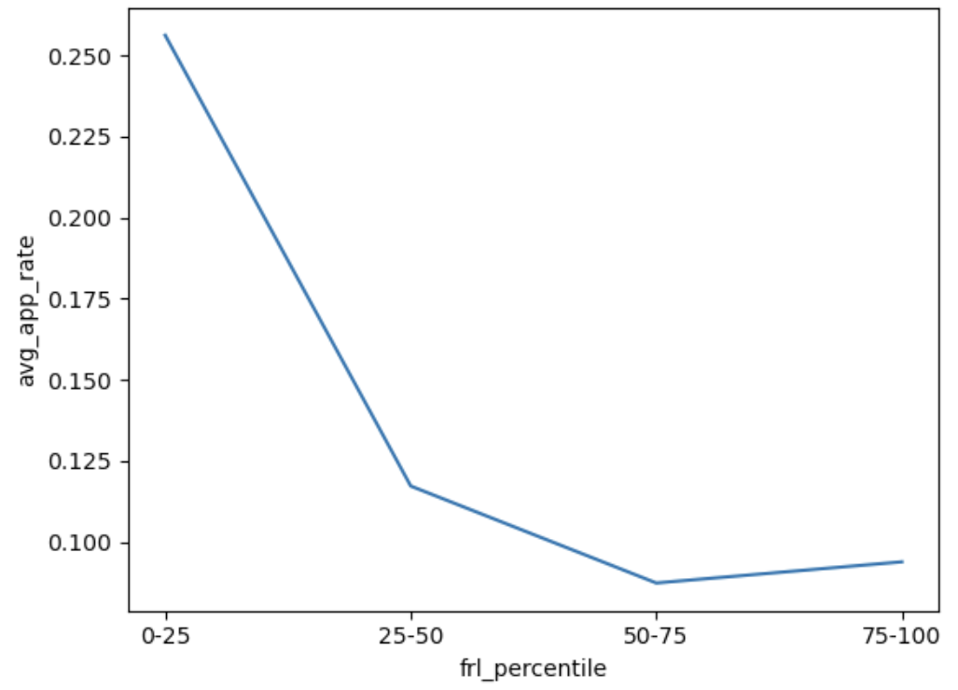
Summarizing patterns
Depending on the audience, we may or may not want to show every data point.
A
B
Another nice option: Make the points nearly transparent and overlay a bold curve on top!
Note: The 0–25 frl_percentile bin consists of the 25% of schools with the lowest values of pct_free_reduced.
It is not all schools where 0 < pct_free_reduced < 0.25.

Slide 43
Tidy data
What data is needed to make this plot?
Tidy data: Each row represents one data point in the plot.
There are 4 points in the plot.
So, 4 rows are needed.
Each point has 2 features: frl_percentile and avg_app_rate.
So, we need 2 columns.

Slide 44
Tidy data
frl_percentile | avg_app_rate
0–25 | 0.26
25–50 | 0.12
50–75 | 0.087
75–100 | 0.094
How do we generate this data?

Slide 45
Writing visualization code with Seaborn
Plotting function goes here: scatterplot, lineplot, histplot, etc.
Extra formatting arguments go here: this is look-it-up or ask-an-LLM territory!
sns.scatterplot(df_new, x='pct_frl', y='app_rate', size='grade_12', ...)
Your dataframe goes here
Columns with information for x, y, color, size, etc. go here

Slide 46
Fundamental Operations So Far
View a preview of a dataframe.
Select specific columns.
Create new columns.
Filter to specific rows.
Order the data by the values in a column.
Calculate summary statistics for one or more columns.
Visualize 1D (one dimensional) data with a boxplot or histogram.
Visualize 2D data with a scatterplot or lineplot.
Group by some variable, and then do something (most often, aggregate).
English: "For each unique value of COLUMN(S), do SOMETHING."
🧙 Grouping and visualizing → Majority of EDA with tabular data!

Slide 47
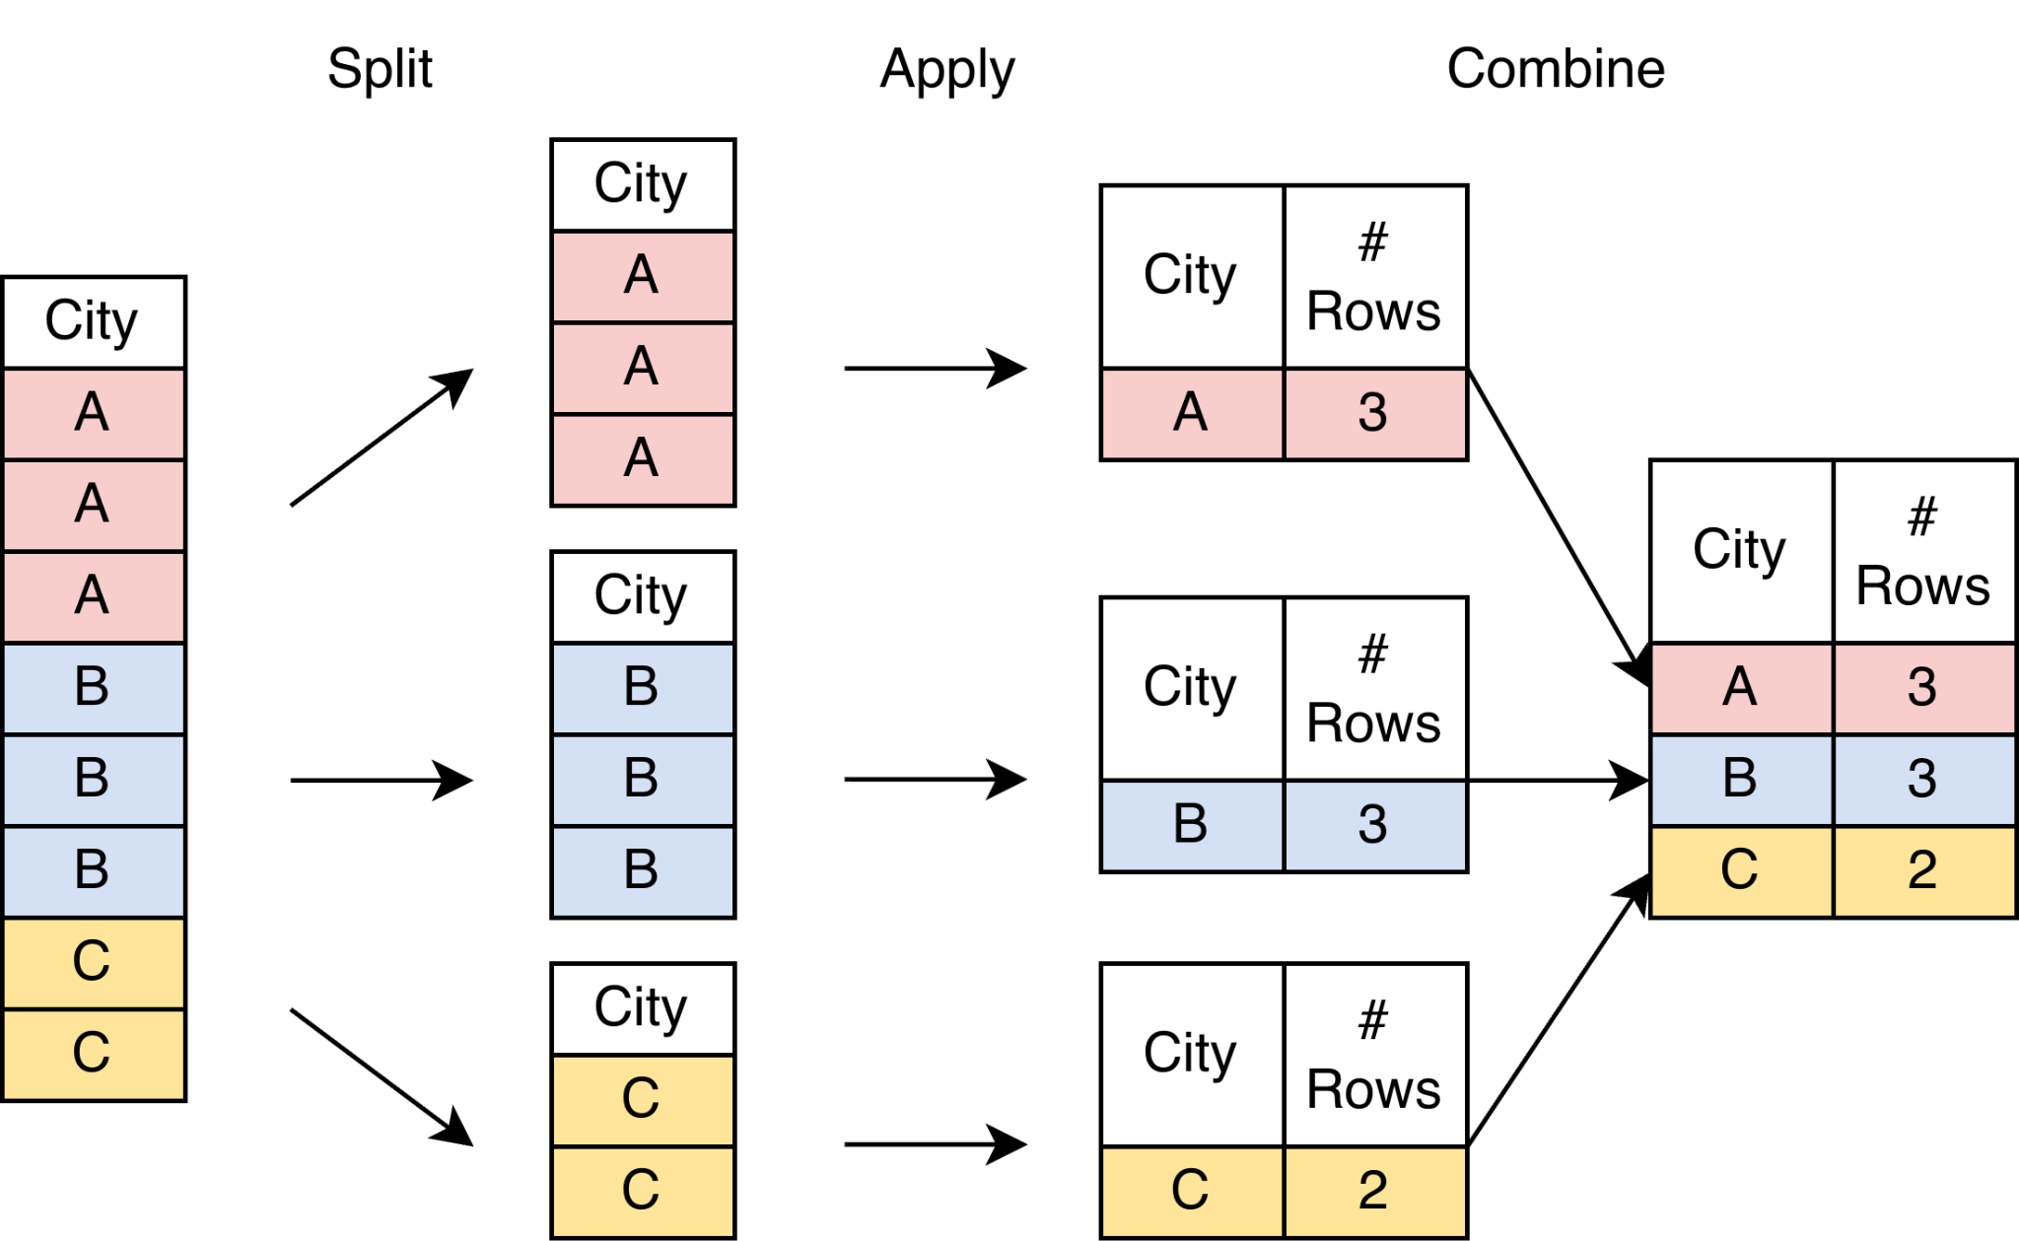
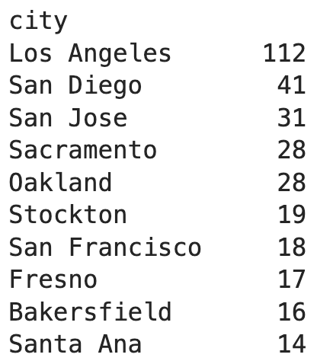
Split-Apply-Combine Paradigm
Step 1: Split
(by city)
Step 2: Apply
(count rows)
Step 3: Combine
"For each unique value of city, count the number of rows."

Slide 48
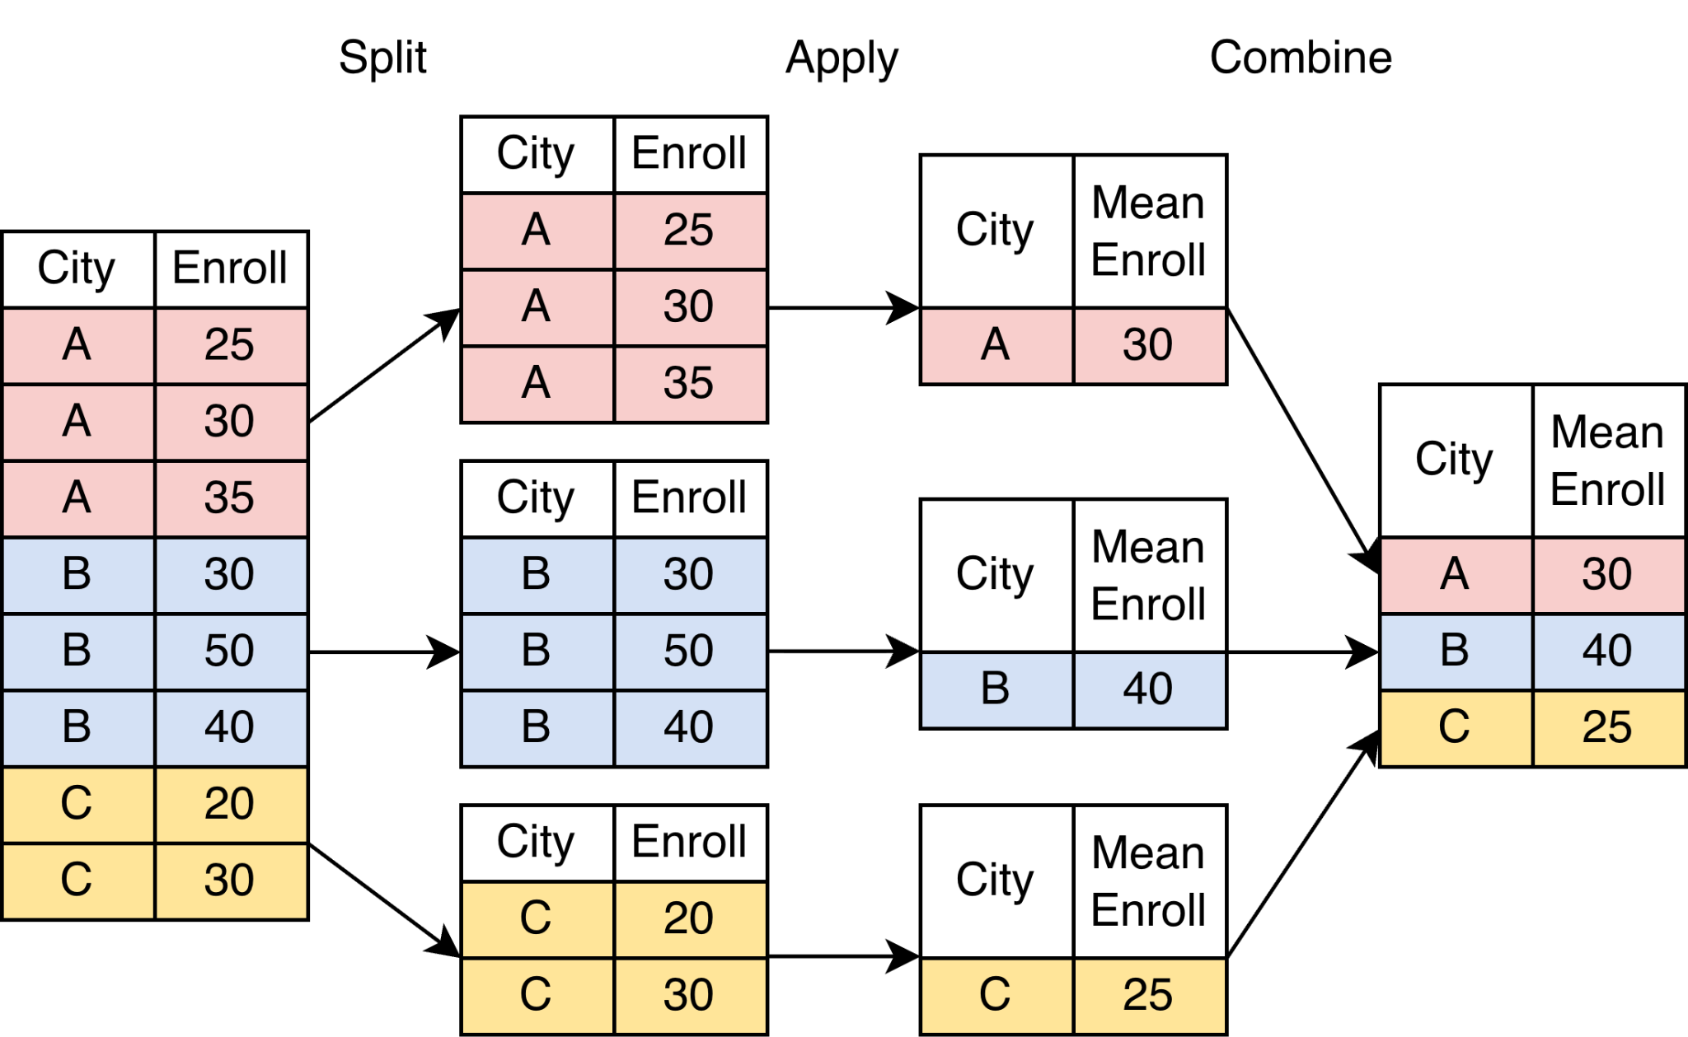
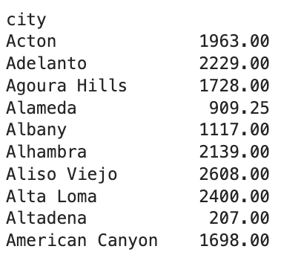
Split-Apply-Combine Paradigm
Step 1: Split
(by city)
Step 2: Apply
(average tot_enrolled)
Step 3: Combine
Josh grew up here!
One big high school.
"For each unique value of city, compute the mean # of students enrolled across its schools."

Slide 49
Exploratory Data Analysis (EDA) II
LECTURE 3
Data 100/Data 200, Fall 2026 @ UC Berkeley
Ramesh Sridharan and Jeremy Sanchez
Content credit: Acknowledgments

